Slide 1
C# Dynamic Link Libraries (DLL)s
Lecture 17

Slide 2
What is DLLs
dll file contains compiled code you can use in your application to perform specific program functions and may be required by another application or module (such as . exe or . dll) to load it through an entry point.
It is a library that contains code and data that can be used by more than one program at the same time.

Slide 3
What is DLLs
Dynamic Link Libraries (DLL)s are like EXEs but they are not directly executable.
That is to say, DLLs are MS's implementation of shared libraries.
DLLs are so much like an EXE that the file format itself is the same.
Both EXE and DLLs are based on the Portable Executable (PE) file format. DLLs can also contain COM component object model and .NET libraries.

Slide 4
What does a DLL contain?
A DLL contains functions, classes, variables, UIs and resources (such as icons, images, files, ...) that an EXE, or other DLL uses.

Slide 5
Types of libraries:
On virtually all operating systems, there are 2 types of libraries.
Static libraries and dynamic libraries.
In windows the file extensions are as follows:
Static libraries (.lib) and dynamic libraries (.dll).
The main difference is that static libraries are linked to the executable at compile time; whereas dynamic linked libraries are not linked until run-time.

Slide 6
More on static and dynamic libraries:
You don't normally see static libraries though on your computer, because a static library is embedded directly inside of a module (EXE or DLL). A dynamic library is a stand-alone file.
A DLL can be changed at any time and is only loaded at runtime when an EXE explicitly loads the DLL.
A static library cannot be changed once it is compiled within the EXE.
A DLL can be updated individually without updating the EXE itself.

Slide 7
How to Create a DLL file
Open Visual Studio then select "File" -> "New" -> "Project..." then seelct "Visual C#" -> "Class library“.
In the class of namespace, write methods for the calculations/different functionality.
Build the solution (F6). If the build is successful then you will see a “ProjName.dll" file in the "bin/debug" directory of your project.
We have created our DLL file. Now we will use it in another application.

Slide 8
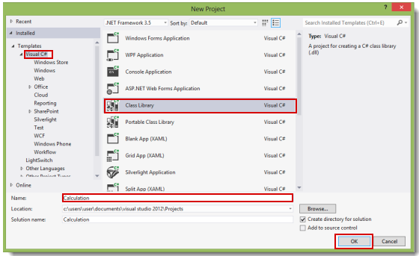

Slide 9
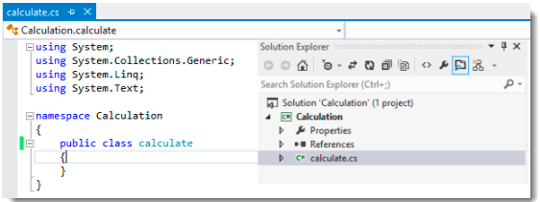
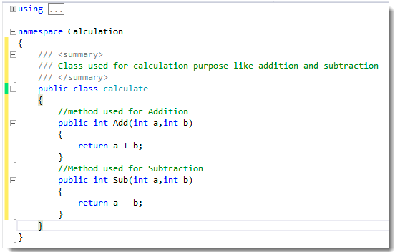
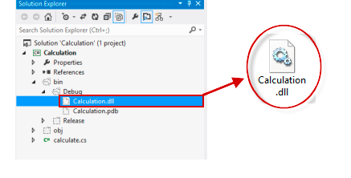

Slide 10
Using DLL File
Open Visual Studio then select "File" -> "New" -> "Project..." then select "Visual C#" -> "Windows Forms application".
Design the form
Add a reference for the dll file, "calculation.dll", that we created earlier. Right-click on the project and then click on "Add reference".
Select the DLL file and add it to the project.
After adding the file, you will see that the dll namespace has been added (in references)
Static methods can be used directly with class name
For non static methods create an object of the class of the dll and use methods with the object.

Slide 11
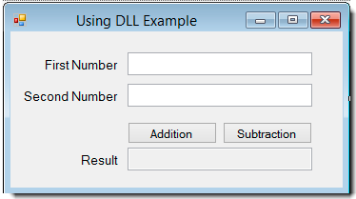
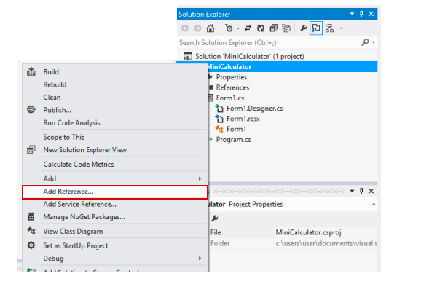

Slide 12
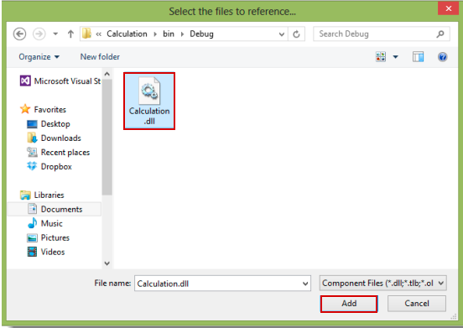
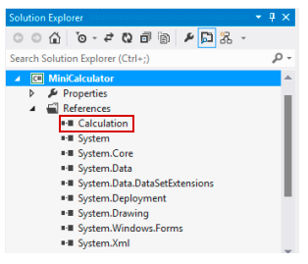

Slide 13
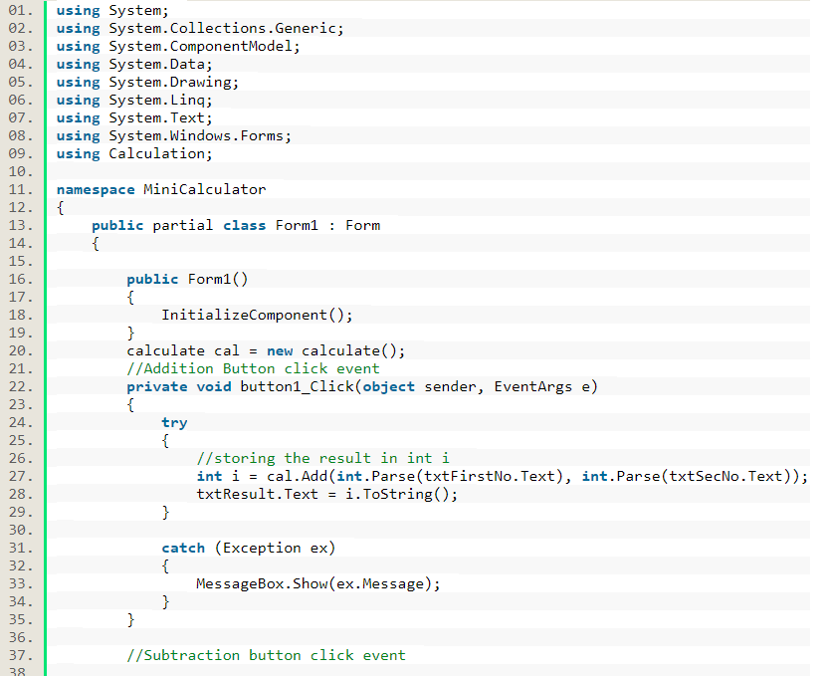

Slide 14
Assignment
Create a windows form application for performing following arithmetic operations
Addition
Subtraction
Multiplication
Factorial
Create a MathFunction Dll and add all the above functions in it
Now by using dll functions perform calculation in your windows form application.

